Slide 1
Xilinx Device Driver Structure
Zynq
Vivado 2015.2 Version

Slide 2
Objectives
After completing this module, you will be able to:
Describe device drivers architecture
Distinguish between Level 0, Level-1 and Level-2 device drivers

Slide 3
Device Drivers
The Xilinx device drivers are designed to meet the following objectives:
Provide maximum portability
The device drivers are provided as ANSI C source code. ANSI C was chosen to maximize portability across processors and development tools.
Support FPGA configurability
Supports multiple instances of the device without code duplication for each instance, while at the same time managing unique characteristics on a per-instance basis
Support simple and complex use cases
A layered device driver architecture provides both
Simple device drivers with minimal memory footprints
Full-featured device drivers with larger memory footprints
Ease of use and maintenance
Xilinx uses coding standards and provides well-documented source code for developers. The API for all device drivers is consistent to provide a similar look and feel between drivers.
Notes:
The Xilinx device drivers are designed to meet the following goals and objectives.
Provide maximum portability: The device drivers are provided as ANSI C source code. ANSI C was chosen to maximize portability across processors and development tools. Source code is provided both to aid designers in debugging their applications as well as modifying or optimizing the device driver if necessary. A layered device-driver architecture additionally separates device communication from processor and Real Time Operating System (RTOS) dependencies. This provides portability of core device driver functionality across processors and operating systems.
Support FPGA configurability: Because FPGA-based devices can be parameterized to provide varying functionality, the device drivers must support this varying functionality. The configurability of device drivers should be supported at compile time and at run time. Run-time configurability provides the flexibility required for future dynamic system reconfiguration. In addition, a device driver supports multiple instances of the device without code duplication for each instance, while at the same time managing unique characteristics on a per-instance basis.
Support simple and complex use cases: Device drivers are required for simple tasks, such as board bring-up and testing, as well as complex embedded system applications. A layered device driver architecture provides both simple device drivers with minimal memory footprints and more robust, full-featured device drivers with larger memory footprints.
Ease of use and maintenance: Xilinx makes use of coding standards and provides well-documented source code to give developers (for example, customers and internal development) a consistent view of source code that is easy to understand and maintain. In addition, the API for all device drivers is consistent to provide a similar look and feel between drivers.

Slide 4
Drivers: Level 0/Level 1/Level 2
The layered architecture provides seamless integration with…
(Level 2) RTOS application layer
(Level 1) High-level device drivers that are full-featured and portable across operating systems and processors
(Level 0) Low-level drivers for simple use cases
Level 2, RTOS Adaptation
Level 1, High-level Drivers
Level 0, Low-level Drivers
Notes:
The layered architecture accommodates the many use cases of device drivers, while providing portability across operating systems, toolsets, and processors. The layered architecture also provides seamless integration with an RTOS (Layer 2), with high-level device drivers that are full-featured and portable across operating systems and processors (Layer 1) and with low-level drivers for simple use cases (Layer 0). You can choose to use any and all layers.

Slide 5
Drivers: Level 0
Consists of low-level device drivers
Implemented as macros and functions that are designed to allow a developer to create a small system
Characteristics:
Small memory footprint
Little to no error checking is performed
Supports primary device features only
No support of device configuration parameters
Supports multiple instances of a device with base address input to the API
Polled I/O only
Blocking function calls

Slide 6
Drivers: Level 1
Consists of high-level device drivers
Implemented as macros and functions and designed to allow a developer to utilize all of the features of a device
Characteristics:
Abstract API that isolates the API from hardware device changes
Supports device configuration parameters
Supports multiple instances of a device
Polled and interrupt driven I/O
Non-blocking function calls to aid complex applications
May have a large memory footprint
Typically, provides buffer interfaces for data transfers as opposed to byte interfaces

Slide 7
Example: GPIO – Level 0 Drivers
Location: {project}/{project}.sdk/{project}_bsp/ps7_cortexa9_0/libsrc/gpio_v4_0/src Ex: c:/Lab4Lab4.sdk/Lab4_bsp/ps7_cortexa9_0/libsrc/gpio_v4_0/src
Xgpio_l: XGpio_WriteReg, XGpio_ReadReg
#define XGpio_WriteReg(BaseAddress, RegOffset, Data) \
XGpio_Out32((BaseAddress) + (RegOffset), (u32)(Data))
#define XGpio_ReadReg(BaseAddress, RegOffset) \
XGpio_In32((BaseAddress) + (RegOffset))
Xgpio_sinit: XGpio_Initialize

Slide 8
Example: GPIO – Level 1 Drivers
Location: {project}/{project}.sdk/{project}_bsp/ps7_cortexa9_0/libsrc/gpio_v4_0/src Ex: c:/Lab4Lab4.sdk/Lab4_bsp/ps7_cortexa9_0/libsrc/gpio_v4_0/src
Xgpio: XGpio_GetDataDirection, XGpio_DiscreteRead, XGpio_DiscreteWrite
The above three Level 1 functions calls the following Level 0 functions: XGpio_WriteReg, XGpio_ReadReg

Slide 9
led_ip drivers: led_ip.c
/***************************** Include Files *******************************/
#include "led_ip.h"
/************************** Function Definitions ***************************/

Slide 10
led_ip drivers: led_ip.h
#ifndef LED_IP_H
#define LED_IP_H
/****************** Include Files ********************/
#include "xil_types.h"
#include "xstatus.h"
#define LED_IP_S_AXI_SLV_REG0_OFFSET 0
#define LED_IP_S_AXI_SLV_REG1_OFFSET 4
#define LED_IP_S_AXI_SLV_REG2_OFFSET 8
#define LED_IP_S_AXI_SLV_REG3_OFFSET 12
#define LED_IP_mWriteReg(BaseAddress, RegOffset, Data) \
Xil_Out32((BaseAddress) + (RegOffset), (u32)(Data))
#define LED_IP_mReadReg(BaseAddress, RegOffset) \
Xil_In32((BaseAddress) + (RegOffset))
XStatus LED_IP_Reg_SelfTest(void * baseaddr_p);
#endif // LED_IP_H

Slide 11
led_ip drivers: led_ip_selftest.c
#include "led_ip.h"
#include "xparameters.h"
#include "stdio.h"
#include "xil_io.h"
#define READ_WRITE_MUL_FACTOR 0x10
XStatus LED_IP_Reg_SelfTest(void * baseaddr_p)
{
u32 baseaddr;
int write_loop_index, read_loop_index;
int Index;
baseaddr = (u32) baseaddr_p;
for (write_loop_index = 0 ; write_loop_index < 4; write_loop_index++)
LED_IP_mWriteReg (baseaddr, write_loop_index*4, (write_loop_index+1)*READ_WRITE_MUL_FACTOR);
for (read_loop_index = 0 ; read_loop_index < 4; read_loop_index++)
if ( LED_IP_mReadReg (baseaddr, read_loop_index*4) != (read_loop_index+1)*READ_WRITE_MUL_FACTOR){
xil_printf ("Error reading register value at address %x\n", (int)baseaddr + read_loop_index*4);
return XST_FAILURE;
}
return XST_SUCCESS;
}

Slide 12
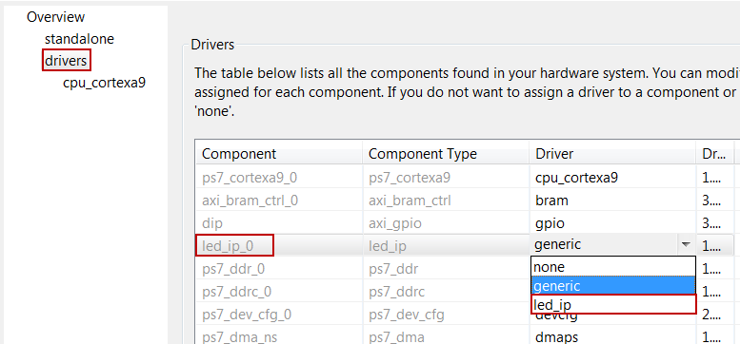
Driver Settings
Select the Drivers panel
By default, the Driver panel displays which device driver is used for each hardware instance in the design
Enables selection of custom drivers and versions for each device in the design

Slide 13
References
Xilinx_drivers.pdf
Xilinx_drivers_guide.pdf
Cortex-A9-MPCore-TRM.pdf

